Slide 1

Session 3: SoftWARE Tools
Tommy Morris
Professor, Electrical and Computer Engineering
Director, Center for Cybersecurity Research and Education
University of Alabama in Huntsville

Slide 2
Tools to InSTALL
OpenPLC Runtime
OpenPLC Editor
Arduino IDE
OpenPLC Arduino Firmware
SCADABr Image
Virtual Box

Slide 3

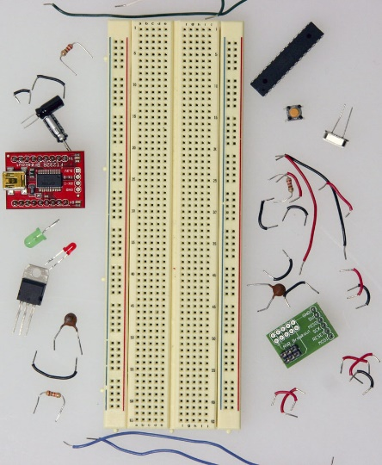
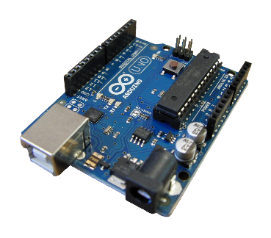
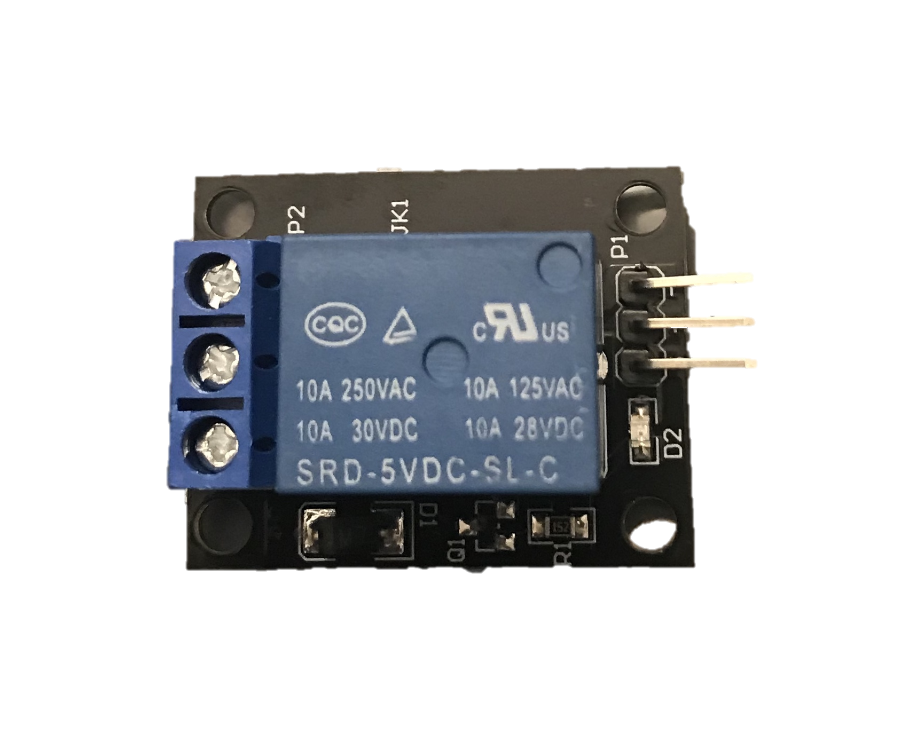
OpenPLC + ArDUINO+PC
OpenPLC runtime runs on PC.
Arduino provides Input/Output (IO): Analog and Digital
Inputs: buttons, sensors (various)
Outputs: LED, relays, speakers, etc.
Host only network from Virtual Box or lab network.

Slide 4
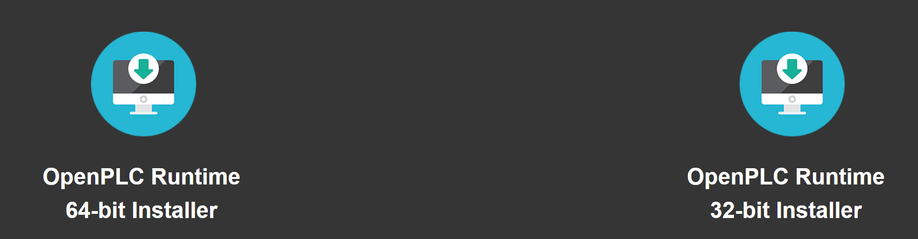
OpenPLC Runtime
Flash drive: OpenPLC Installer x64.exe
This is the PLC application.
The runtime is platform specific. OpenPLC runs on many platforms.
Linux, Windows, Raspberry PI, and others.
Select your platform at https://www.openplcproject.com/runtime
Select one to download
When using OpenPLC with Arduino your PC hosts the runtime. In other words, your PC is the PLC in this case. The Arduino is a slave device for I/O connectivity.
Use the OpenPLC runtime for your operating system. Linux and Windows are supported. 32-bit and 64-bit versions are supported.
The downloaded file is an executable. Download and run to install.

Slide 5
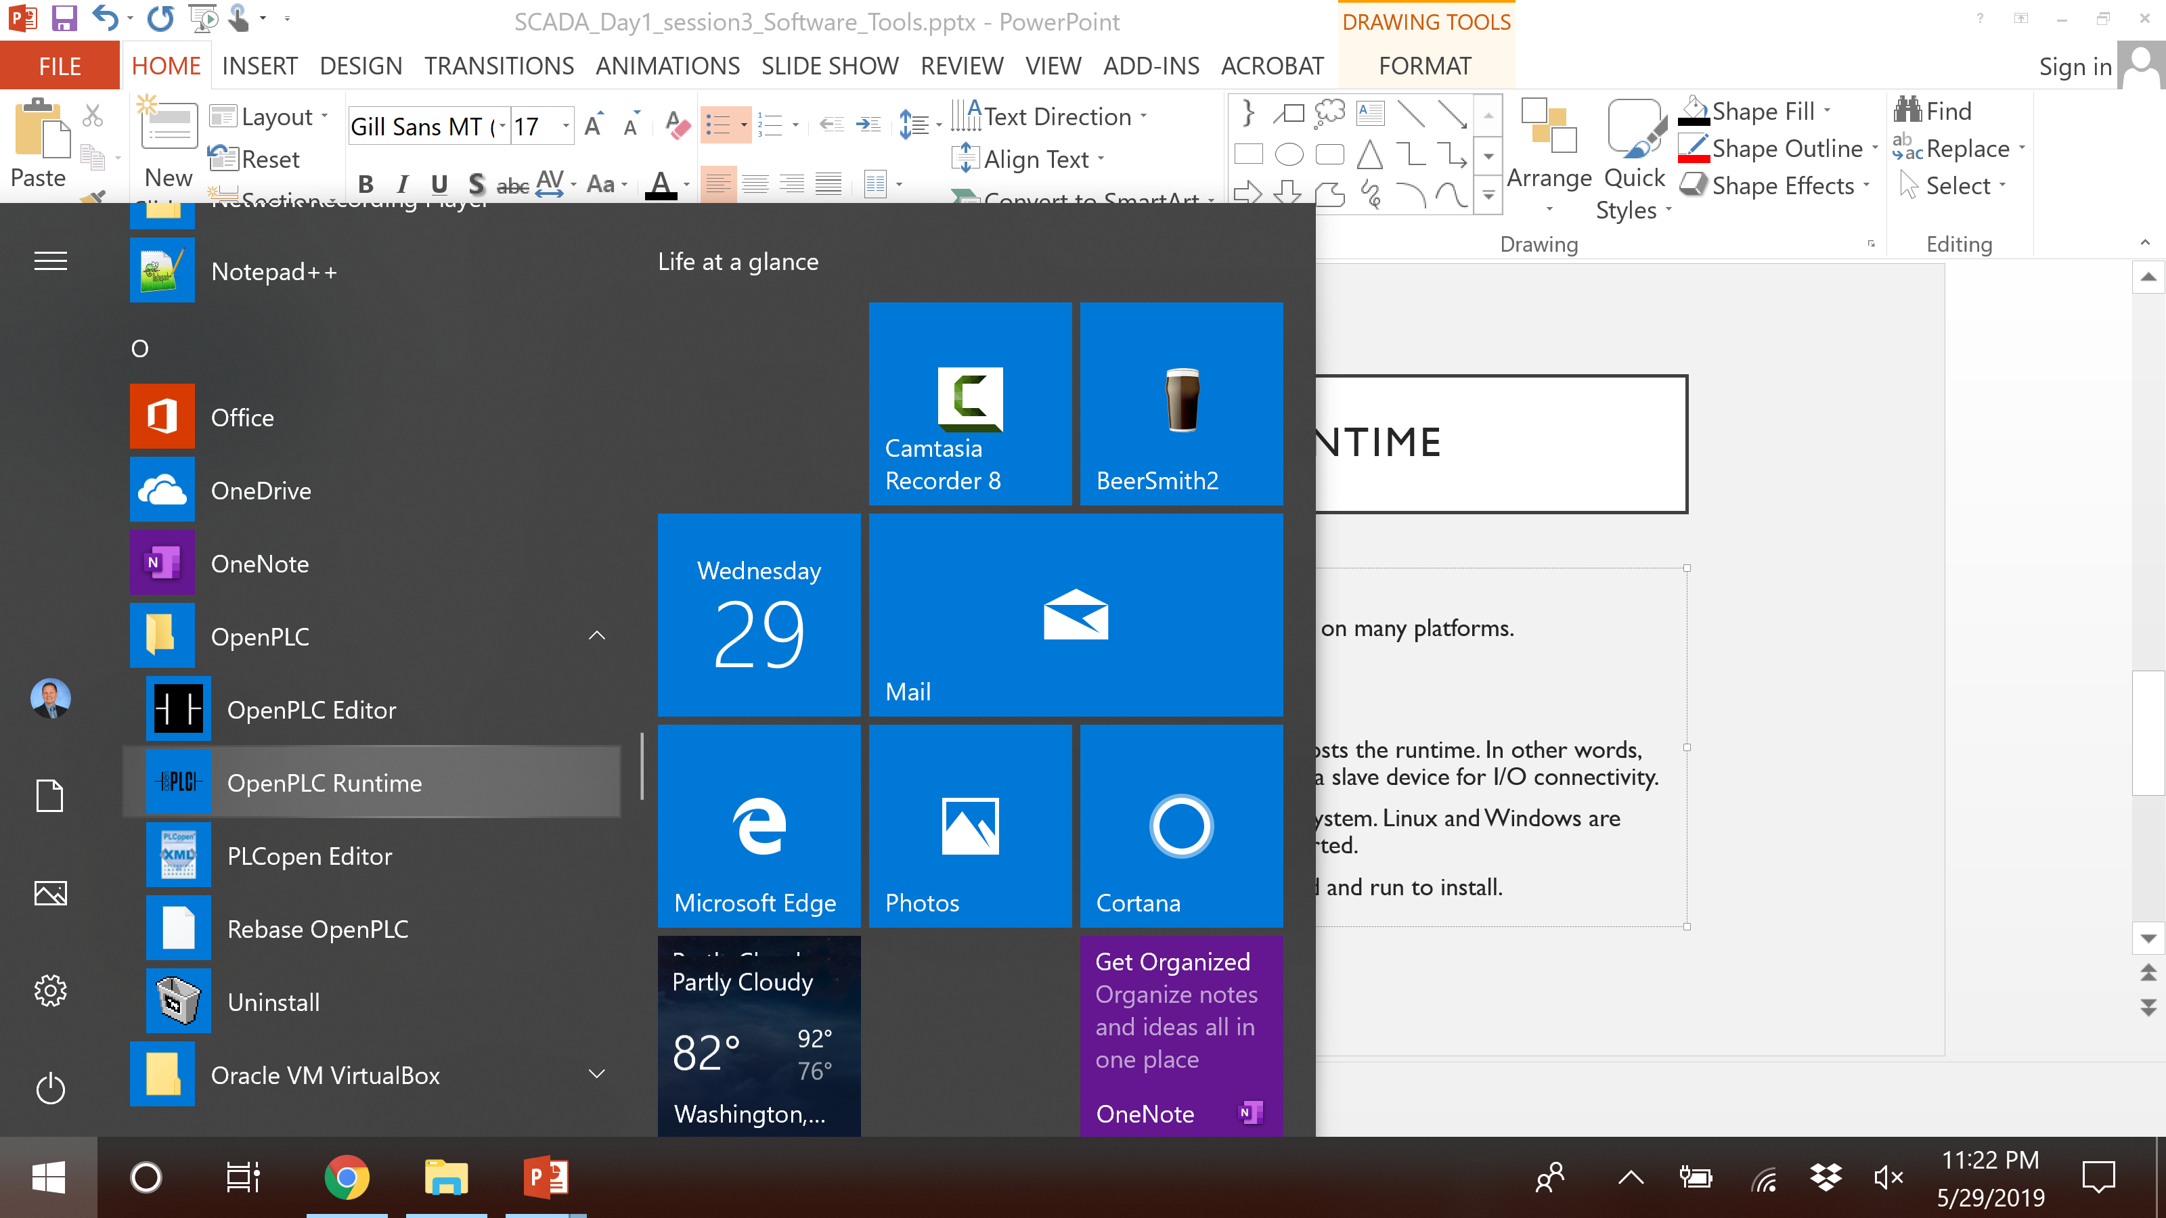
OPENPLC Runtime and Editor in the Start Menu

Slide 6
Arduino IDE
Flash drive: arduino-1.8.9-windows.exe
The IDE is the Arduino programming and debugging environment.
OpenPLC runs firmware on the Arduino to access its GPIO (General Purpose Input Output) and A/D (Analog to Digital) pins.
Download the IDE here:
https://www.arduino.cc/en/Main/Software
Be sure to choose the IDE, not the web editor.

Slide 7

Arduino OpenPLC Firmware
Flash drive: OpenPLC_Uno_v3.zip
The Arduino OpenPLC Firmware must be installed and executed on the Arduino.
The Arduino Firmware is available here:
https://www.openplcproject.com/getting-started-arduino
Choose the firmware for UNO.
The download is a ZIP file.
Extract the Zip
Open the firmware in the Arduino IDE and open in the Arduino IDE (select the OpenPLC_Uno.ino when opening).
Upload the firmware to the Arduino
Connect your USB cable
CTRL-U to upload (or press the → button)
Tools -> Port
Set COM3

Slide 8
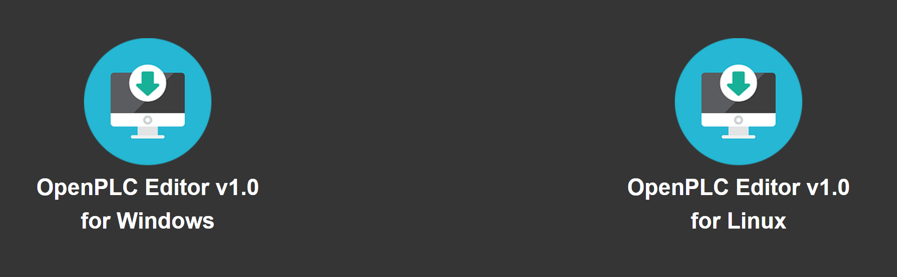
OPENPLC Editor
The OpenPLC Editor is available at:
https://www.openplcproject.com/plcopen-editor
Choose the version for your host PC.
Instructions for Windows
Download, unzip, and double-click on the OpenPLC Editor shortcut.
Note: The windows version of the editor comes with the runtime installer. No need to download and install this separate for Windows.
Instructions for Linux
Download, unzip, and run on terminal: ./install.sh
Once the installation finishes, a shortcut for OpenPLC Editor will be created on the Applications menu.

Slide 9
SCADABR
SCADABr is distributed as a Virtual Box VM image.
Links are available for Virtual Box and the SCADABr .ova file at https://www.openplcproject.com/reference-installing-scadabr
Virtual Box: https://www.virtualbox.org/wiki/Downloads
SCADABr ova: https://drive.google.com/file/d/1gEOZmN9_Nt5shXy4iYS1z_EMxB4r0Kzh/view?usp=sharing

Slide 10
SCADABR
Virtual Box Installation
Download the .exe for your host.
Run the .exe file and follow directions from the installer.
SCADABr .ova installation
Run Virtual Box from the start menu
Use File -> Import Appliance
Select your .ova file
Change the network setting to

Slide 11
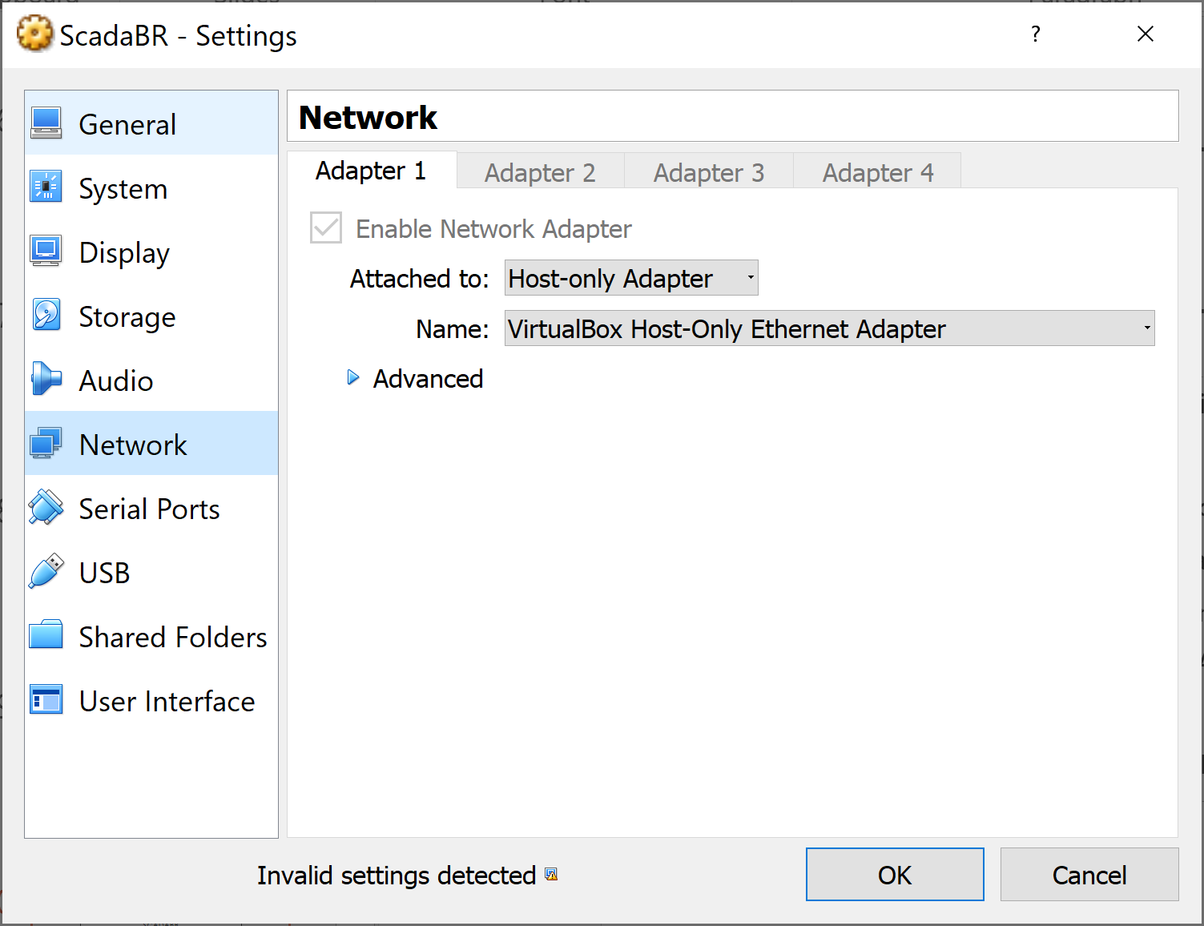
Virtual Box Network Setting
While the SCADABr VM is off
select Settings
then select Network
Set “Attached to:” to “Host-only Adapter”
The Host Only IP address can be found (and set) under Preferences -> Network -> Host Only Networks
Select the appropriate adapter
You will need this IP to connect SCADABr from your host’s browser the PLC running on your host.

Slide 12
Starting up
Build your circuit and connect to the Arduino Uno pins
Build your Ladder Logic and save it
Launch the Arduino IDE
Upload the OpenPLC firmware
Launch the OpenPLC runtime
Run the application from the start menu
In your host’s browser open localhost:8080 - this is the OpenPLC configuration port
Launch the SCADABr HMI
Start the SCADABr VM.
Read the SCADABr URL from the VM (should be http://192.168.56.101:8080/ScadaBR)
Open the URL in your host’s browser
Repeat every time you run.

Slide 13
RunTIME ERROR
Some participants got an error similar to “Verifying Installation. Press any key to exit.”
Fix: Reinstall Cygwin manually and rebase
Download https://cygwin.com/setup-x86_64.exe
Install: install directory: c:\users\%USERNAME%\openplc\runtime
Select all defaults
Run start menu -> OpenPLC -> Rebase OpenPLC (this take a while)
Try the runtime again

Slide 14
Passwords
OpenPLC website: http://localhost:8080
User:openplc
Pass: openplc
SCADA Br website: https://192.168.56.101:8080/ScadaBr (or similar IP)
User: admin
Pass: admin
Virtual SCADA VM
User:scada
Pass: scada

Slide 15
OPENPLC DASHBOARD
Access the OpenPLC dashboard via your host’s browser.
URL: http://localhost:8080/
User: openplc, Password: openplc (change in Users menu)
Common functions from the dashboard
Start/Stop the PLC
Load/Remove programs
Add Slave Device

Slide 16
Load a Program
Select “Programs” on the left hand side menu
Choose a file (suffix .st)
Select “Upload Program”
On the next screen
give the program a name and description (optional)
press “Upload program”
After the compile finishes, select “Go to dashboard”
Select “Start PLC” on the left hand side

Slide 17
Remove a Program
Select “Programs” on the left hand side menu
Select an existing program from the table
Select “Remove program”
Note: “Reload program” will recompile the program. Do not use this with a new version.
When you have a new version
Remove the old version (to avoid confusion)
Upload the new version

Slide 18
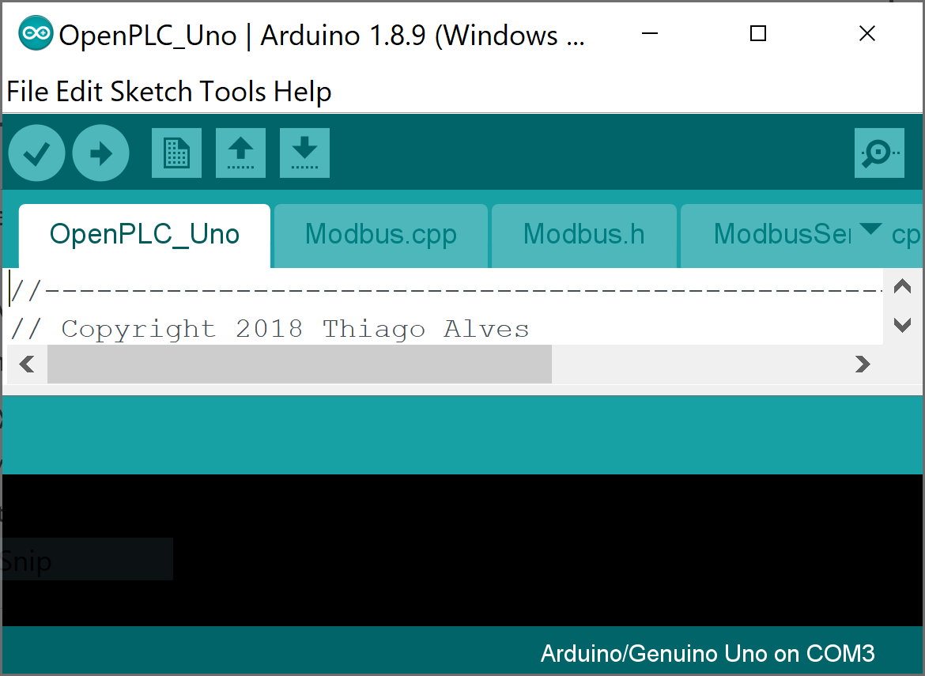
Add a Slave Device
From the OpenPLC Dashboard select “Slave Devices” on the left hand side menu
Select “Add New Device”
On the next screen
Name your device
Set device type to Arduino Uno
Select the appropriate COM port (should be COM3)
Click “Save Device”

Slide 19
Placing Components in OpenPLC Editor
Left click the component icon
Left click the location in the ladder section for the component

Slide 20
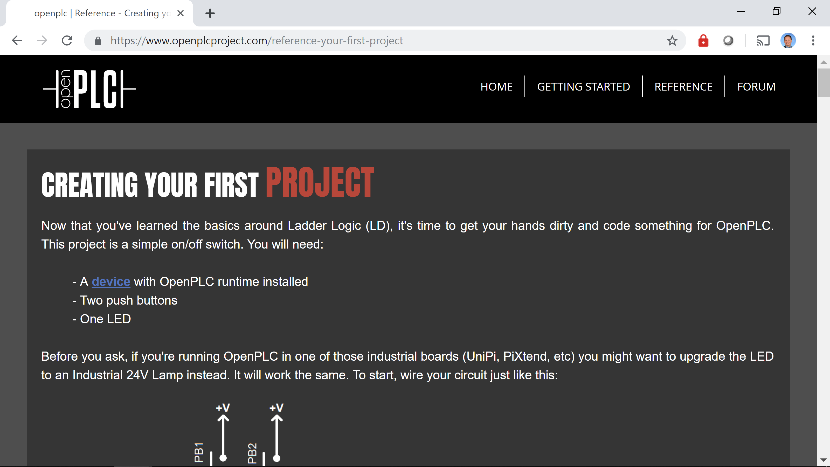
ExerCISE 1
Complete the exercise from https://www.openplcproject.com/reference-your-first-project
Note: there is no HMI for this exercise.

